Slide 1
More Java and Objects

Slide 2
Review
Java has
  Methods(functions) – do stuff
  Variables – hold information
  Classes(objects) – are things

Slide 3
Review
Java is a language with rules
  Sentances are “statements” and end with a ;
    int x = 7;
  Comments are blocked with // or /* */
    //A single line comment
    /* Multi line
    Comment */
  We can create “blocks” of code with { }
    if(x < 8){
    x++;
    System.out.println("We increased x!");
    }

Slide 4
Review - Booleans
Booleans logic determines whether a condition is true or false
We can create complex conditions with && (and) and || (or) operators.
  if((itIsEarly() && iHaveToGetUp()) || theresAFire())
  GetOutOfBed();

Slide 5
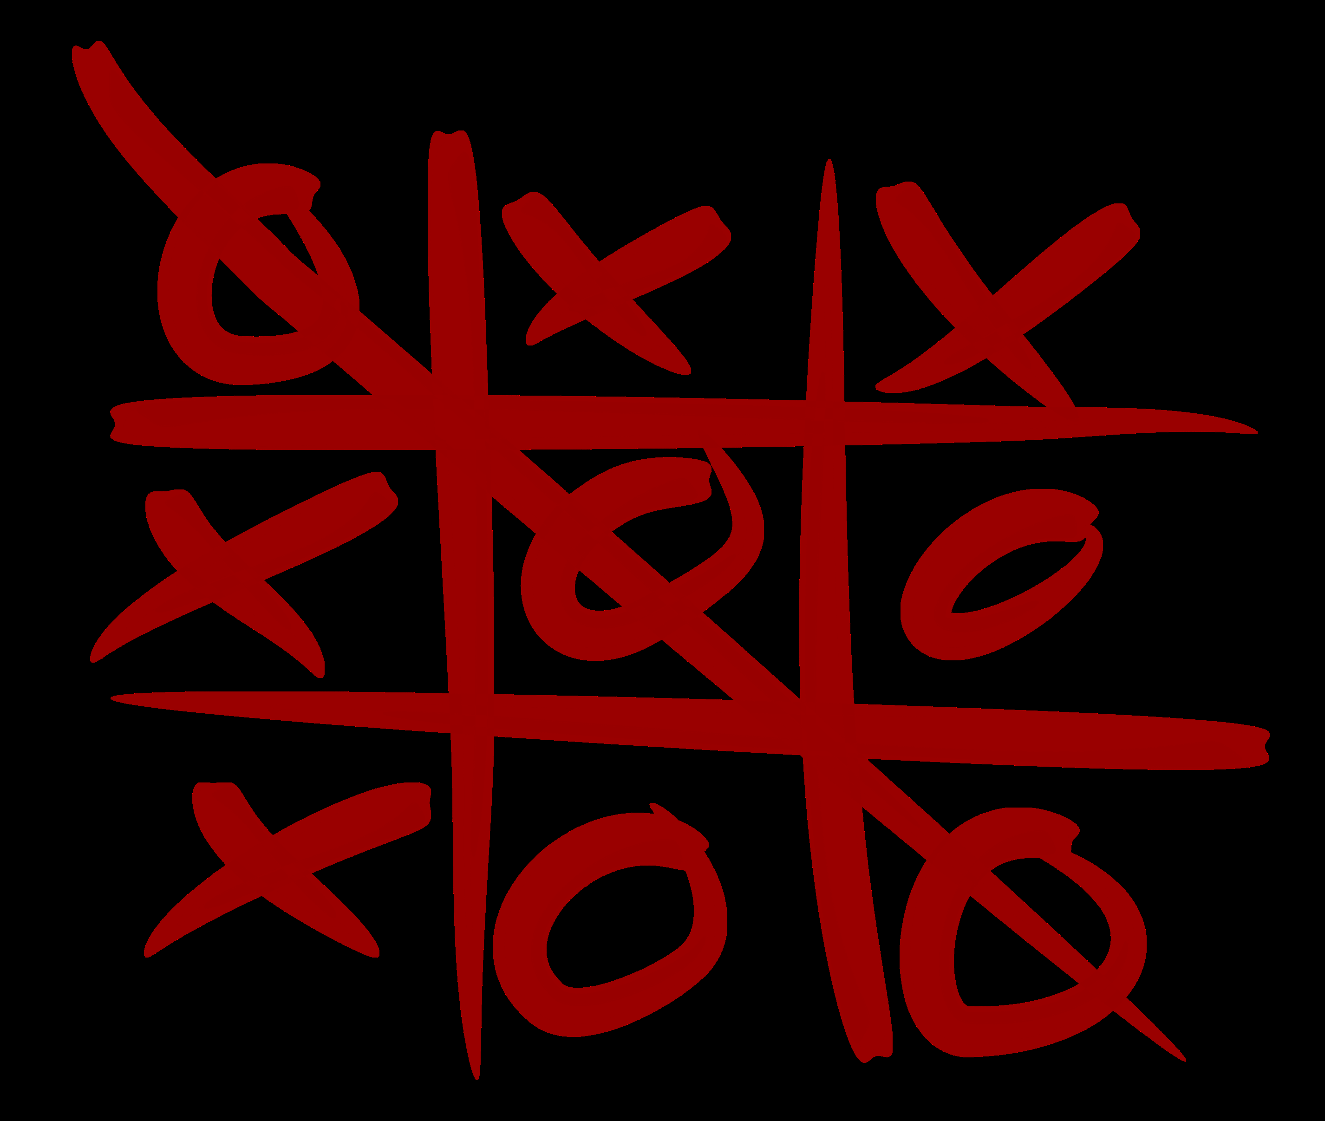
Booleans
How many different ways can you win tic-tac-toe?

Slide 6
New Game
Avoid the Things
  Download the game
  Play
How can we win/make the game better
Share

Slide 7
New Concept - levels
We're stuck at level 1
How can we level up?
How do we represent colors
  - reds, greens, blues
    #FF7722
    Color(25, 120, 0)
How can we change the difficulty of the level with the background color
Updating the display

Slide 8

Explore Concept: Levels

Slide 9
New Concepts – Enemies
Groups of Objects we've used arrays (crafting table) which are basic (we have to know the size!)
Java Collections – a more advanced way of grouping objects: List, Map, Set
The types of enemies in our game are stored in a List
  List<EnemyInfo> enemyInformation = new ArrayList<EnemyInfo>();
When we want to add a new enemy type we can do this:
  EnemyInfo myEnemyInfo = new EnemyInfo(true, 0, 0, 255, 0, 30);
  enemyInformation.add(myEnemyInfo);
When we want to get one of our enemy types we can do this:
  enemyInformation.get(index);

Slide 10
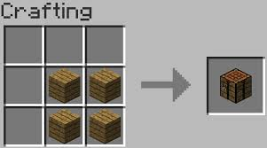
New Concept – Enemies
Groups of Objects we've used arrays (crafting table) which are basic (we have to know the size!)

Slide 11
New Concept - Enemies
Java Collections – a more advanced way of grouping objects: List, Map, Set
The types of enemies in our game are stored in a List
  List<EnemyInfo> enemyInformation = new ArrayList<EnemyInfo>();
When we want to add a new enemy type we can do this:
  EnemyInfo myEnemyInfo = new EnemyInfo(true, 0, 0, 255, 0, 30);
  enemyInformation.add(myEnemyInfo);
When we want to get one of our enemy types we can do this:
  enemyInformation.get(index);

Slide 12
New Concepts – Enemies
Let's create some new enemies:
  //EnemyInfo(boolean accel, int r, int g, int b, int speed, int aiLevel)
  enemyInformation.add(new EnemyInfo(true, 0, 0, 255, 0, 30));
How are enemies generated?
  Look at enemyStuff() and addEnemy(level)

Slide 13
Enhancing Concepts
Bonus Level
  player.setPowerful(true);
Lives
  Uncomment the code in Player.act()
Other?

Slide 14
Sharing

